Slide 1



GOLDEN EMPIRE Council
2023
KICKOFF!

Slide 2

WHY POPCORN?
Fund Your Adventures
Examples
Campouts
Blue & Gold Celebration
Pinewood Derby
High Adventures
Equipment needs
Advancement
Annual dues
Scouts Learn
The value of hard work
How to earn their own way
Public speaking
Salesmanship and people skills
Setting and achieving goals
Money management
Scouts Earn Rewards
Amazon e-gift cards
Millions of rewards to choose from

Slide 3
2022 Sales
$601,295

Slide 4
U
N
I
T
S
National Rankings:
Pack 37: #79
Right on!
*Roughly 9,000 Units sold popcorn this Fall

Slide 5
S
C
O
U
T
S
National Rankings:
Bryce S: #49
Yousef O: #81
Right on!
*Roughly 90,000 Scouts sold popcorn this Fall

Slide 6

WAYS TO SELL

Slide 7
WAYS TO SELL
STOREFRONT SALES
WAGON SALES
ONLINE DIRECT
Leverage high foot traffic retailers
Reserved by Unit Leaders
Sign up to sell in person at a store
$162 per hour National average
One parent and one Scout cover more hours
Set your storefront split method in the Leader Portal before storefront sales begin
Any ‘Face to Face’ sale not at a storefront.
Deliver product to your family, friends and neighbors' homes
Ask parents to ask their co-workers
Mark sales delivered or undelivered
Delivered: Check out popcorn in advance, and deliver products
Undelivered: Take order and deliver products later
Always have an adult with you
Ship direct to your customers
Record in the app
Share your page via email, text, social media or QR code
No handling of products or cash
$65 Average Order
Products & prices may vary
Shipping/Tax may apply
Available year-round

Slide 8
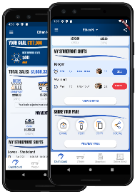
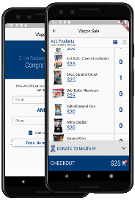
ONLINE SALES
Via the Trail’s End App
No Cash or Product Handling
$65 Average Order Value
SHARE YOUR PAGE
Share your fundraising page
via email, text, or social media.
Customers click your link to place online orders.
Products ship directly to your customer’s home.
DIRECT ORDERS
Pick your products.
Credit or debit payments only
Products ship directly to your customer’s home.
TIP: Additionally share your page during online holidays: Amazon Prime Day in July & October*, Black Friday & Cyber Monday
*Subject to Change

Slide 9

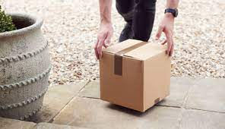
ONLINE SALES
www.trails-end.com
Shipping Information
Effective 7/5/2023
$65+ Free Shipping (vs. $70)
$10.99 Paid Freight (vs. $13.99)
+$3.00 Handling
  Microwave, Popping, Sea Salt Snack Pack (new)

Slide 10
TRAIL’S END TECHNOLOGY FOR LEADERS
MAKE YOUR SALE EASY!
Trail’s End App for Scouts
Text APP to 62771 to download / register
Record sales (accept credit cards)
Storefront sign up
Track goals’ progress
Record deliveries
Share online sale page
Claim rewards
Unit Leader Portal
www.trails-end.com/leader
Place Popcorn Orders
Manage all things sale-related
Mobile-friendly portal via your phone’s browser
When Scouts use the app, Leaders can:
  Track progress toward goals
  Inventory monitoring
  Oversee storefront sign-ups
  Storefront setups
  Split sales
  Manage accounting and more!
TIP: ALL Credit Card Fees Paid by Trail’s End when sales recorded via the APP

Slide 11
CREDIT CARDS
Many consumers prefer credit or debit card transactions
  “Advise your customers we prefer credit or debit payments”
Trail’s End & GEC covers credit card fees for transactions recorded via the APP*
Earn more Reward points for every $1 sold app credit card
No cash handling for Scouts or Unit Leaders
Square readers are compatible with the Trail’s End App
Square Bluetooth readers also accept Apple Pay and Google Pay
ALL Scouts can enter credit cards manually
Parents pay Wagon Sales cash due by clicking “Pay Now” on the Wagon Sale screen**
*TIP: Recording sales via the Trail’s End app is required for credit card fees to be covered (Square app not required)
**NOTE: Using Pay Now does not qualify as a credit card sale towards Trail’s End rewards points

Slide 12
RECRUIT A SCOUT
The ‘Recruit a Scout’ feature in the App allows you
to collect contact info from families interested in
joining Scouting while selling popcorn. The
completed form triggers an email to the Unit Leader,
the Council, and the potential recruit gets an
email with for more information.

Slide 13
A SUCCESSFUL SALE

Slide 14
A SUCCESSFUL SALE
Unit Leader Preparation
Attend Webinars & Training Tab
Plan your program year & key adventures
Set budget and goals via the Unit Leader Planner
If participating in Trail’s End Storefront program, reserve prime hours at prime locations
Secure your own additional storefront hours if needed
Obtain supplies:
  Square Readers
  Storefront supplies
  Unit incentives
Review the Unit Leader Portal training tab
Prepare for your Unit Kickoff
Prepare your Scouts & Families
New Scout? Download the app
  Text APP to 62771 to download/register
Setup accounts in the app (One Account per Scout)
Encourage Scouts to review the training tab
Motivate with incentives and how you will use the funds
Communicate key dates and progress

Slide 15
BUDGET & GOAL
PLAN YOUR ADVENTURES FOR THE YEAR!!
Determine Unit expenses
  Dues
  Advancements
  Supplies
  Etc.
PARENTS MUST KNOW WHAT THEY GET FOR HITTING THE GOAL!
Utilize the Unit Leader Planner tool (storefront hours, budgeting, goal setting)
Set Unit and individual Scout sales goals
Decide on Unit incentives for Scouts
Obtain Kernel Guide for planning (TE Leader Portal)

Slide 16
UNIT KICKOFF
Make it fun
Create excitement with food, games, and prizes
Set Stretch Goals
Review your program calendar and Unit sales goals
Assist Scouts to set their individual goals
Get started with the Trail’s End App
Scouts who sold previously use the same account
New Scouts set up an account
Each Scout requires their own account
Talk about prizes
Trail’s End Rewards – Amazon Gift Cards
Council & Unit Incentives
Training
Role play to train kids how to sell
Direct Scouts/families to the training resources in the App
Review key dates

Slide 17
CREATE AN ENGAGING & ENERGETIC PITCH FOR THE SALE!
GET READY TO SELL
Sell More Perfect Your Sales Pitch
Big smile, make eye contact, introduce yourself, and which pack you are a part of
“Hello, I’m [Your First Name] from [Pack#]”
Let people know your goals
“I’m earning my way to [adventure or summer camp”]
Close your sale
“Can I count on your support today?”
Thank your customer and end your sale
“Thank you, we prefer credit / debit payment”
Look Sharp, Be Prepared
Always wear your Class A field uniform
Always speak clearly and say, “Thank you!”
Download the app and login in advance
Grow your sales by asking every customer
Know your products
Be ready to answer “What is your favorite flavor and why?”
Ask the customer for their support of your Scouting activities.
Tell your customer what being a Scout means to you
TIP: Visit the app training section: How to guides, tips, and resources

Slide 18
2023 TRAINING
& LIVE SUPPORT

Slide 19
UNIT LEADER WEBINARS
Attend Live Moderated Webinars
Register at www.trails-end.com/webinars
New & Existing Unit Kernels are encouraged to attend
Sessions run from July 6 – Sept 9
Training Tab in Unit Leader Portal
Review recorded webinar videos, separated by topic

Slide 20
TRAIL’S END
MANAGED STOREFRONTS
Prime hours and prime locations booked by Trail’s End
Plenty of hours still available!!
Benefits
Saves Unit Leaders time
Provides more opportunities for all Scouts to earn their way
Improves relationships with store managers

Slide 21
UNIT BOOKED STOREFRONTS
Best practices when booking your own storefronts:
Determine high foot traffic days, times, and locations (Google Analytics)
Book one to two months in advance
Visit the store in your Uniform with one or more Scouts
Shop the store, then request to speak with the manager
If permission is granted, ask for and notate expectations and follow the rules
Always say ‘Thank you!”

Slide 22
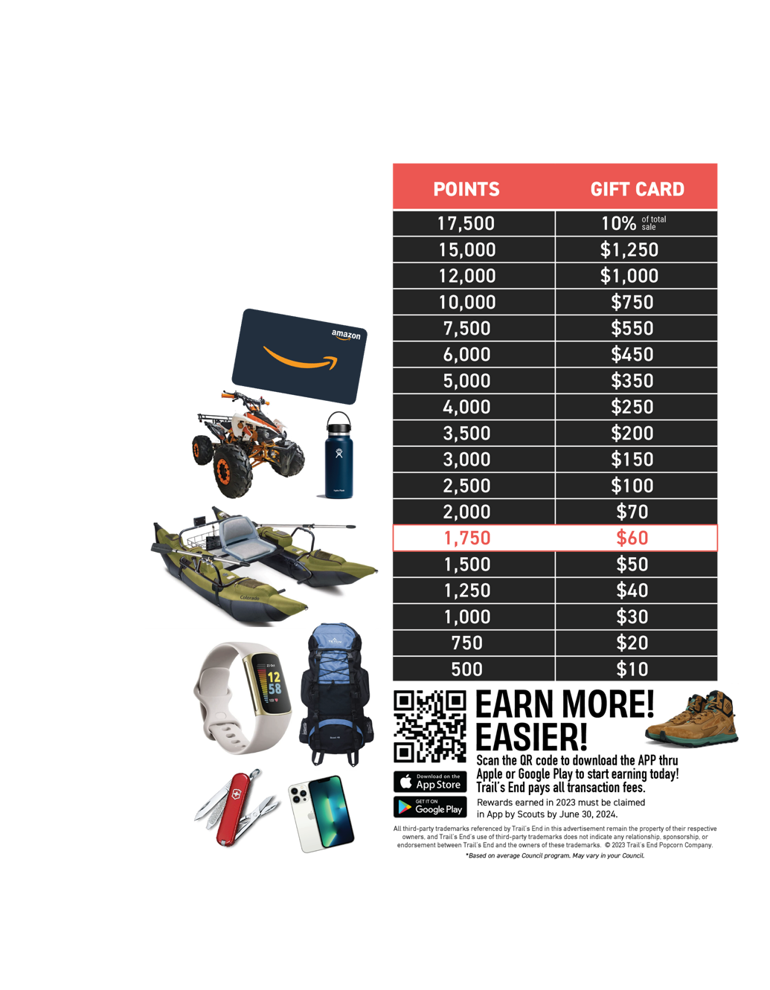
REWARDS
Record all sales via the App to qualify
Scouts earn points
1.25 points for every $1 sold app credit card and online
1 point for every $1 sold app cash
Receive an Amazon e-gift card
Scouts choose prize(s) from Amazon.com
Did You Know?!?
1,750 points ($1,500 in sales) provide funds for most Scouts’ Year of Scouting, including registration fees, handbook, uniform, Pack dues, camp, Scout Life magazine, and much more.
Plus, Scouts earn a $60 Amazon e-Gift card!*

Slide 23








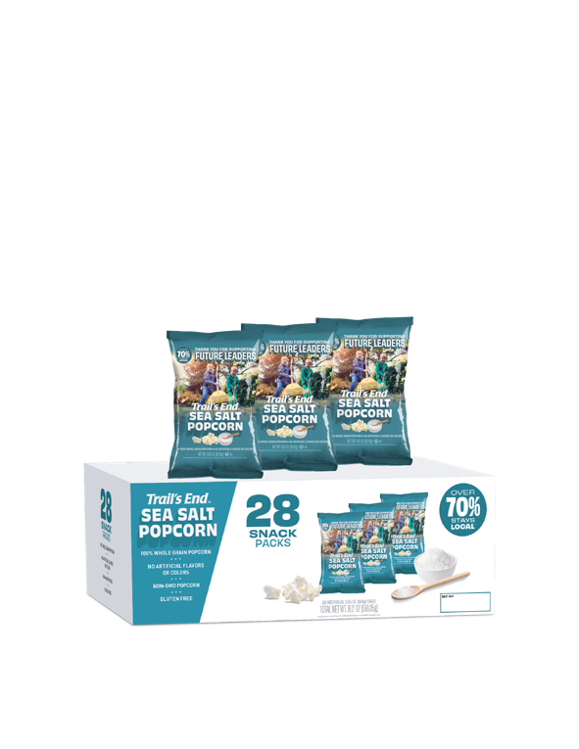







TRAIL’S END 2023
TRADITIONAL PRODUCTS
Sweet and Salty
Kettle Corn
S’mores Popcorn
Popping Corn
White Cheddar Popcorn
$15
$15
$20
$25
Unbelievable
Butter Microwave Popcorn
Salted
Caramel Corn
Chocolatey
Pretzels
Sea Salt
Popcorn
$25
$30
$50
$25

Slide 24
S’MORES ORDERING INFORMATION
S'mores will ship at a maximum of 10% (retail) of your orders to stay in line with market research, prevent excess inventory, and manage production constraints.
For every $3,000 ordered, Units can only order 1 case (12 bags) of S’mores. This applies to S’mores only.

Slide 25
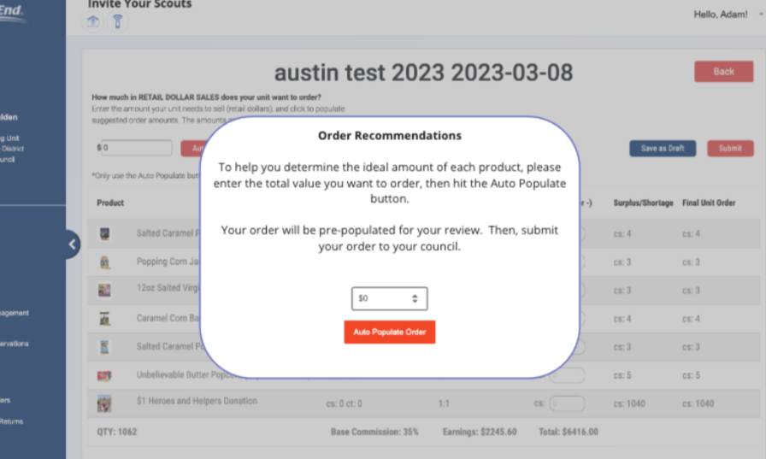
Order Recommendations
With the new products, Trail’s End will help you with your ordering.
Simply enter the $ dollar amount you want to order and qty’s of each item will auto populate.

Slide 26









ONLINE ASSORTMENT
www.trails-end.com
$20
$25
$25
NEW
$27
$34
$50
IMPROVED FLAVOR
NEW
NEW
$42
$47
$72
$62
$54
$45
NEW
NEW
Road Trip Variety Pack
Movie Night Bundle
Picnic Bundle
Let’s Go Hiking Bundle
Ultimate Snack Pack
Game Night Bundle
$27
$35
$30
$55
LIMITED TIME OFFERINGS:
Snowflake Pretzels 7 oz $35
Peppermint Bark 9 oz $40
Dark Choc Sea Salt Caramels 10.5 oz $35
Chocolate Lovers Bundle $95
Chocolate Trio Bundle $110
*Products & Pricing are subject to change

Slide 27
2023 COUNCIL SALE SPECIFICS

Slide 28
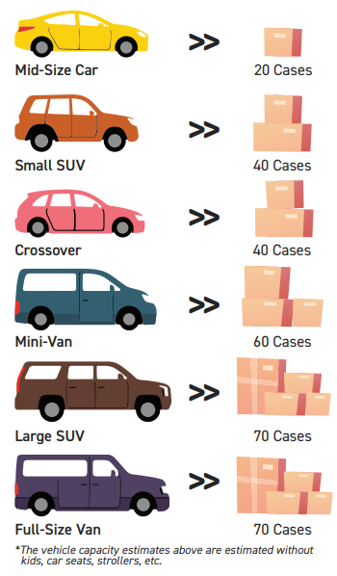
ORDERS & DISTRIBUTION
Order Due Dates
Distribution
1st Order: Friday July 28th
2nd Order: Monday Sept 4th
Final Order: Monday Oct 23rd
1st Order: Friday Aug 18th
2nd Order: Friday Sept 15th
Final Order: Friday Nov 10th
Mother Lode Facility Sacramento
Dixon
Redding

Slide 29
COMMISSION
Commission for ALL Sales
35%
Keeping it SIMPLE!

Slide 30
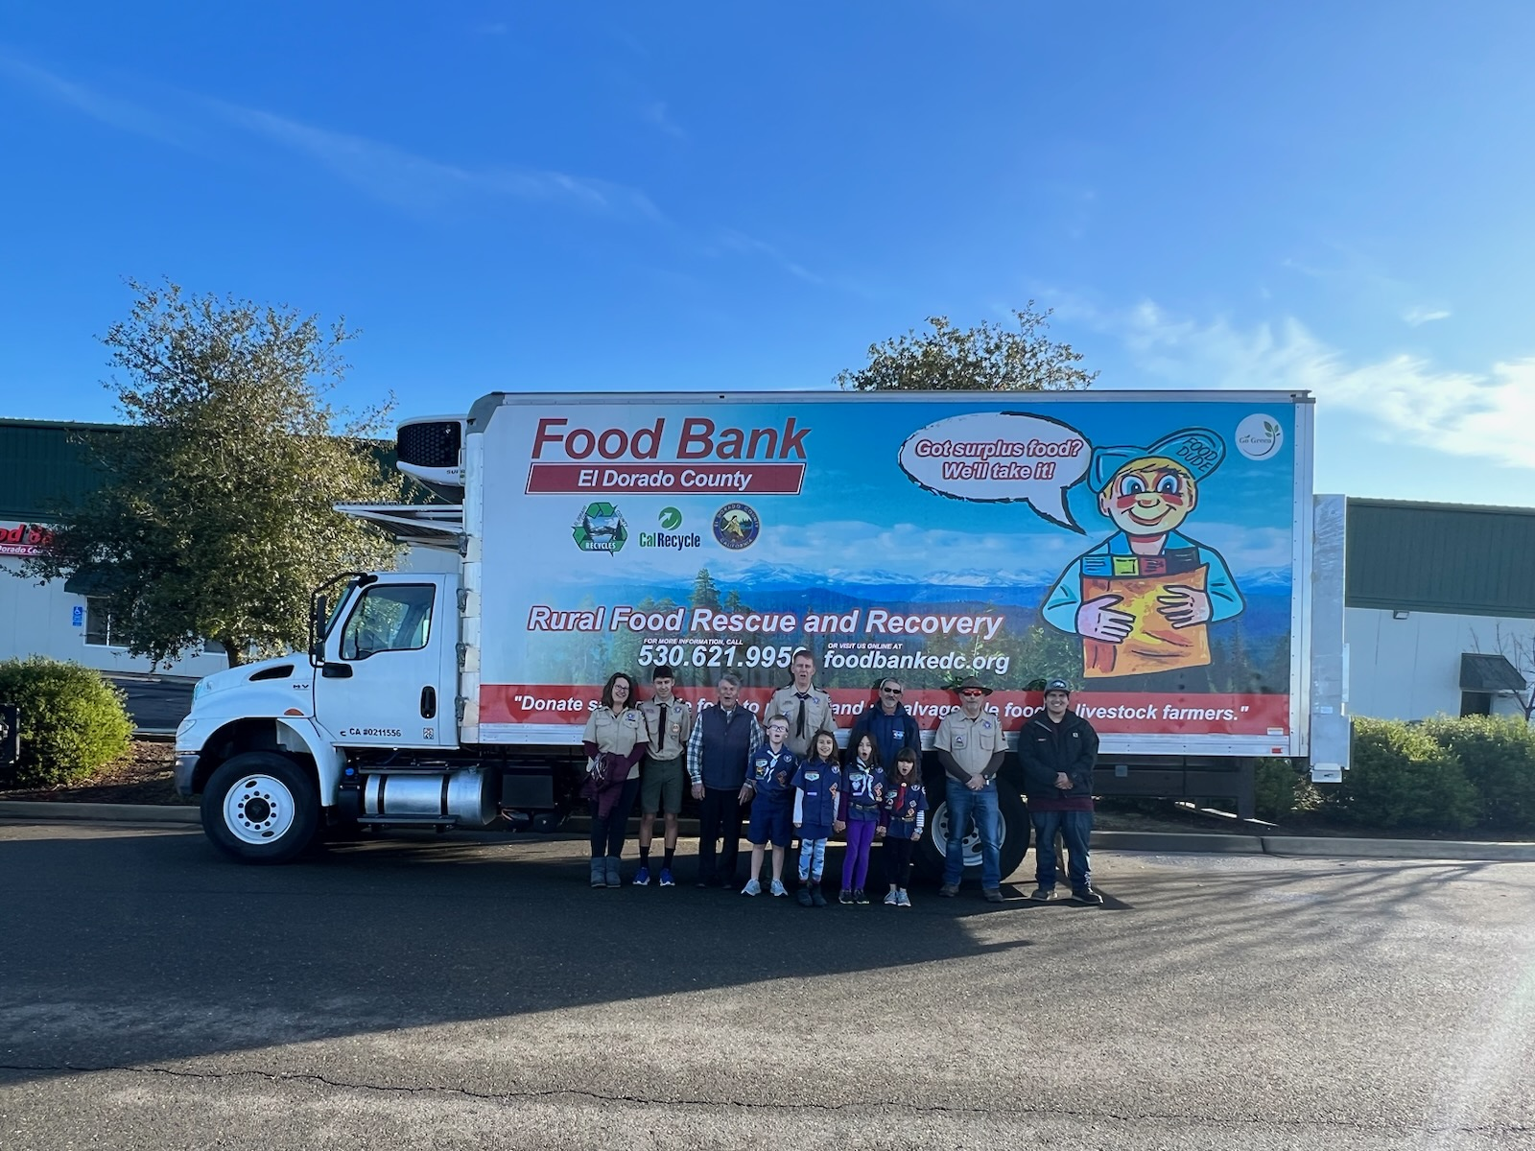
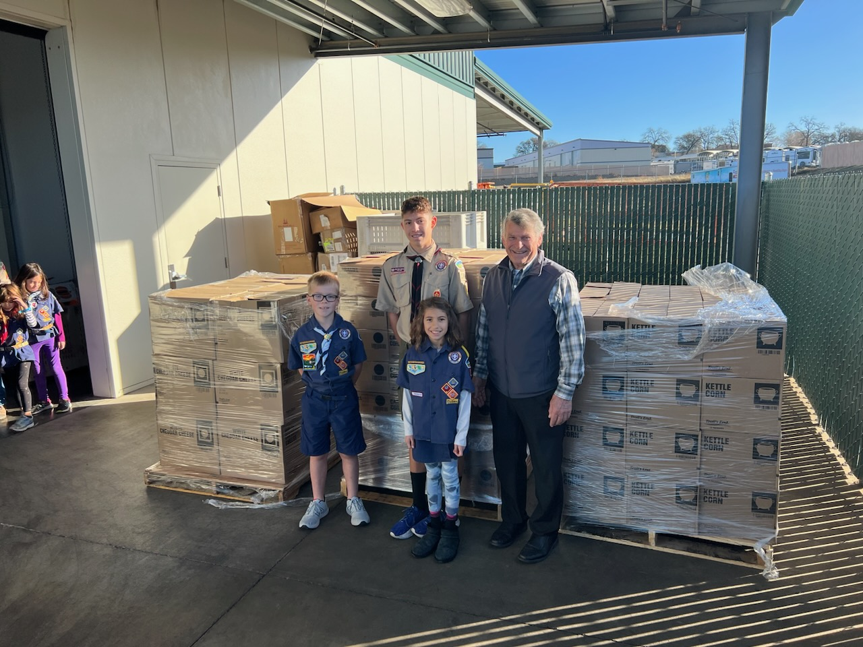
2022 Heroes & Helpers
Over $14,000 of Heroes and Helpers Popcorn was distributed in 2022!

Slide 31
2023 Heroes & Helpers
2023 Heroes & Helpers Patch!
All Scouts that collect and record a minimum of $223 in donations will earn this CSP.
For every 3 Scouts that earn the patch, a leader will earn the patch as well.
100% of donations count towards Unit and scouts Total Sales, Reward Points, and Unit Commissions.
Sample Patch

Slide 32
KERNEL CHECKLIST
July/August
September
October
Determine your budget & set your goals
Place an initial order
Attend a Trail’s End Webinar
Join the Trail’s End Facebook Group
Hold your Unit Kickoff
Sales Begin August 18th
It’s Cub Scout recruiting season! Register their account to sell popcorn!
Check Council calendar for replenishment opportunities
Communicate with your Unit; progress toward goals, storefront opportunities, key dates, etc.
Motivate your Scouts & Families, i.e., incentives and reminders of what funds do for your unit & Scouts.
Collect cash due from Scouts
Place your final order
Distribute popcorn and ensure deliveries are made
Pay your Council invoice or request your payout
Submit rewards for your Scouts
Celebrate your Success!

Slide 33

COMMIT YOUR UNIT!
If you have not registered your unit for the Popcorn Sale, please do so today!
www.trails-end.com/unit-registration
Agenda
Products

Slide 34
HAVE QUESTIONS?
GET ANSWERS
Council Contacts
David Hagar
David.hagar@scouting.org
916-494-3460
Karen Petersen
Karen.petersen@sbcgloal.net
916-873-3333
Trail’s End Support
Join Unit Leader Popcorn Community Group
Text FACEBOOK to 62771
Join Scout Parent Facebook Group
Text PARENTFB to 62771
Visit our FAQ’s
https://support.trails-end.com

Slide 35

THANK YOU!

