Slide 1
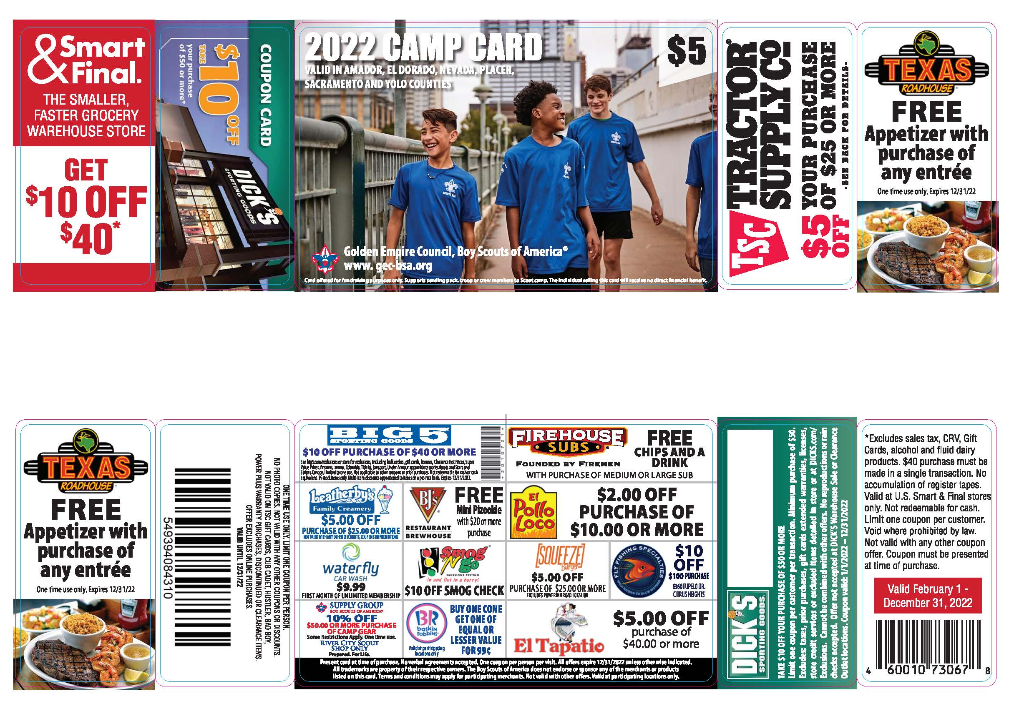
Welcome To 2024 Camp Card Sales Training

Slide 2
Camp Card Sales Training
  Camp Card Sales Timeline
  March 1 – May 29 Camp Card Sale and distribution.
  April Card Re-Distribution in your district
  June 7 Deadline for Card Returns and Final Settlement Due

Slide 3
The PUSH
Camp Card Sales Training
How to Implement Camp Card Sales for Your Unit
Determine NOW the Scouting adventures your youth plan to participate in for 2021-2022.
Determine the number of active youth in your program.
Set a per youth sales goal.
Set an overall unit sales goal.
Communicate unit needs clearly with each youth and parent.
Explain how the sale of Camp Cards teaches youth the value of earning their own way.
Explain exactly where the unit plans to allocate the revenue generated from the sales.
  (i.e. Individual youth camp fees, Unit camp fees, uniforms, etc..)
Communicate Camp Card calendar clearly with all youth and parents.
Have a Kick-off for your unit.
Have Turn-in dates for money and unsold Camp Cards.

Slide 4
Camp Card Sales Training
How to Sell Camp Cards
Your job as Camp Card Chair is to teach Scouts how to sell.
To get there, your team needs to employ both sales methods.
Door to Door ( Wagon Sales) and Store Front.
Create a plan and train your Scouts in both methods; this will give you the best results.

Slide 5
Camp Card Sales Training
Door to Door
Take your Cards for a trip around the neighborhood.
Highlight the some offers.
Also, Encourage them to buy several cards because some offers are one use, and they may want more.
Use the Trails End Phone app to record and possibly increase sales with credit cards and cash.
Let them know your Unit is trying to earn their way to camp.

Slide 6
Camp Card Sale Training
Storefront
. Always follow Local health guidelines and store rules and restrictions.
Set up a sales booth and sell Camp Cards on the spot.
Use the Trails End Phone app to record and possibly increase cash sales and credit cards.
This can be an effective approach in the right location at the right time, but don’t hang your hat on this approach alone.
Focus on multiple locations over the course of a couple of days. (Bring a tent display and posters).

Slide 7
Camp Card Sales Training
Sales Techniques for Scouts
Don’t miss the opportunity to use the Camp Card sale to train your Scouts in public speaking, sales and service. Have your Scouts practice these simple steps:
• Wear your uniform.
Smile and tell them who you are—first name only!
Tell them where you are from (unit within Scouting).
Tell them what you are doing (going Camping).
Tell them what they can do to help (save money with the Camp Card).
Ask them if they would like to buy more than one.
Close the sale and thank them.

Slide 8
Camp Card Sales Training
Safety & Courtesy
• Please wear face covering/mask and practice social distancing while selling Camp Cards.
• Wash hands or use hand sanitizer often while selling.
• Sell with another Scout or with an adult.
• Never enter anyone’s home.
• Never sell after dark, unless with an adult.
• Don’t carry large amounts of cash.
• Always walk on the sidewalk and driveway.
• Say thank you whether or not the prospect buys a Camp Card.

Slide 9
Camp Card Sales Training
For Questions and Information please contact:
Karen Petersen email: karen.petersen@sbcglobal.net Cell: 916-873-3333
David Hagar email: David.hagar@scouting.org Cell: 916-494-3460

Slide 10
Thank you for all you do for scouting

